Slide 1

Founded in 2005; first customer shipment in 2007
More than 37,500 customers in 150+ countries
FY16 $1.4B revenue
49% YoY growth that significantly outpaced the industry
Over 85 of the Fortune 100 and 60% of the Global 2000 rely on us
Excellent global support, awarded by J.D. Power and TSIA
Experienced team of more than 4,100 employees
MISSION
To protect our way of life in the digital age by preventing
successful cyberattacks.
STRATEGIC DIRECTION
To be the leading independent security company by building
the world’s most innovative and effective security platform.
Further questions 07588 473474

Slide 2
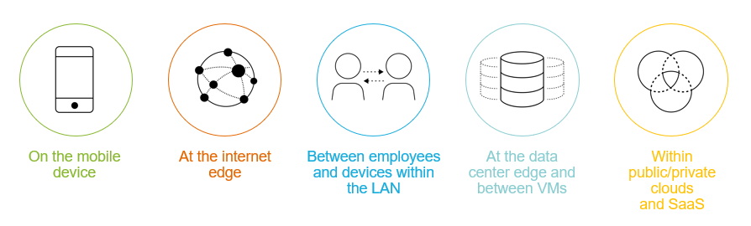
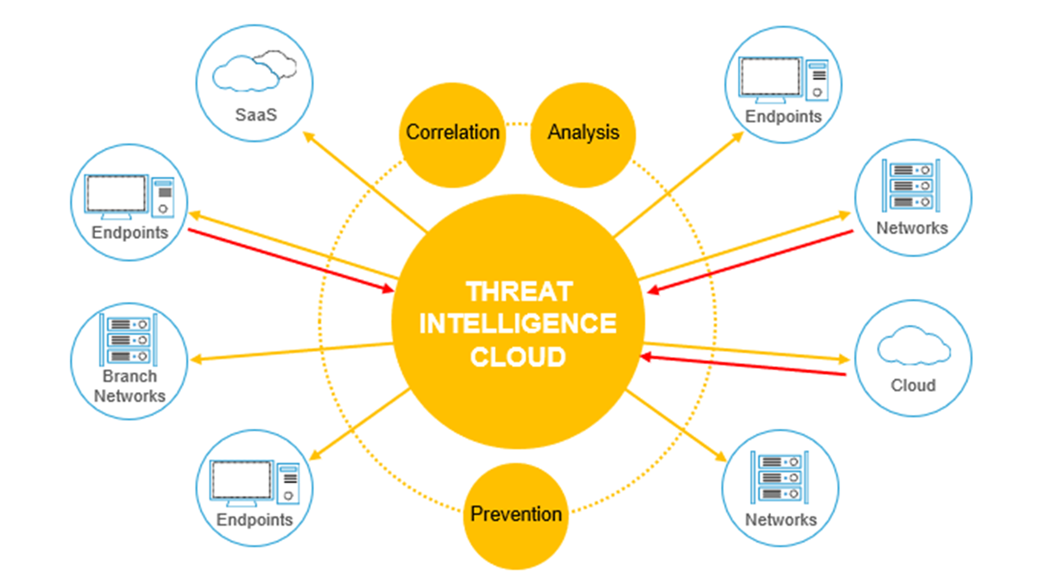
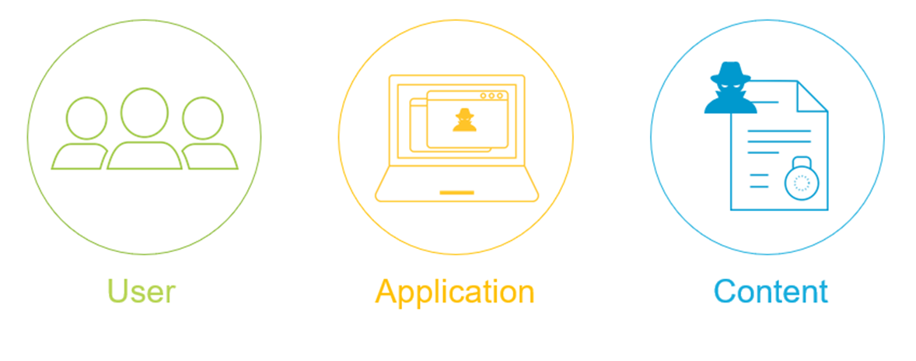
Further questions 07588 473474

Slide 3

AUTR REPORT KEY FINDINGS¹ - ARE YOU KEEPING PACE?
Remote access application usage is rampant
with 78 different apps in use globally
SaaS-based application usage has grown
46% growth in usage, over 300+ SaaS apps, watch out for Shadow IT
Public Cloud is the new DC option of choice with 100’s of apps choices, new vocabulary and bespoke eco system vendors
Executable files are extremely toxic
with nearly half found to be malicious.
Email attachments continue to be a primary attack vector
with high % of attachments malicious.
¹http://connect.paloaltonetworks.com/autr-report
https://www.paloaltonetworks.com/resources/webcasts/threat-trends
Further questions 07588 473474

Slide 4
PONEMON KEY FINDINGS² - ARE YOU KEEPING PACE?
Time to deter the majority of attacks is 40Hrs
60% of all attackers move on to another target after this time
Typical Vs Excellent Security
70Hrs to 147Hrs means attackers are more likely to “change target”
Increased usage of low-cost and effective toolkits
63% Reporting increased use, 64% saying they are highly effective
Cost and time to plan and execute attacks is decreasing
Hacking tools have improved, 53% of respondents
Attackers are opportunistic
Adversaries go after the easiest targets first, 72% of respondents
²http://researchcenter.paloaltonetworks.com/2016/02/for-cyberattackers-time-is-the-enemy
Further questions 07588 473474

Slide 5
HOW AM I DOING? ARE YOU KEEPING PACE?
Where are my weaknesses and what should I do to improve my defences and close any gaps? How do I measure success?
Relative to my industry, are my users the main source of Information Security Risk?
Am I already compromised, if so, how bad is it? What’s the frequency?
What am I being attacked with? How sophisticated is it? I am being attacked more than my peers?
Further questions 07588 473474

Slide 6

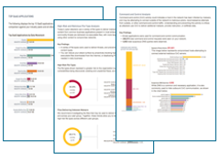
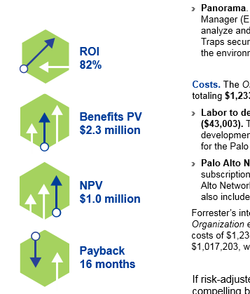
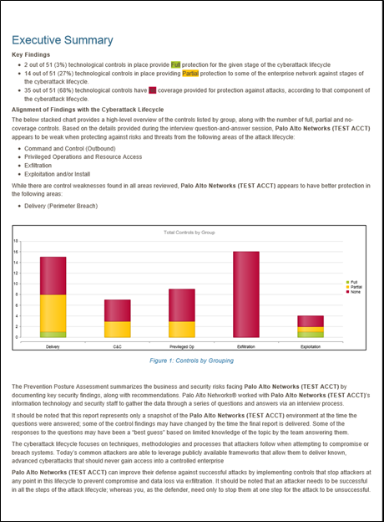
HOW AM I DOING? ARE YOU KEEPING PACE?
Where are my weaknesses and what should I do to improve my defences and close any gaps? How do I measure success?

Slide 7
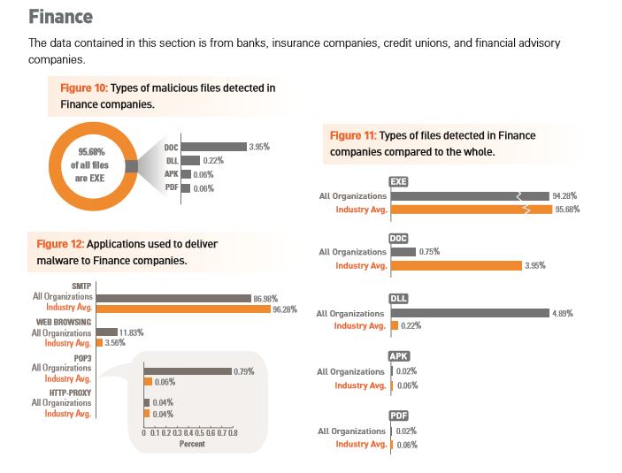
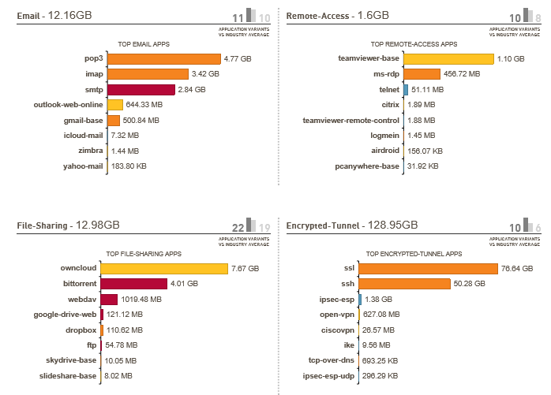
HOW AM I DOING? ARE YOU KEEPING PACE?
Where are my weaknesses and what should I do to improve my defences? How do I measure success?

Slide 8
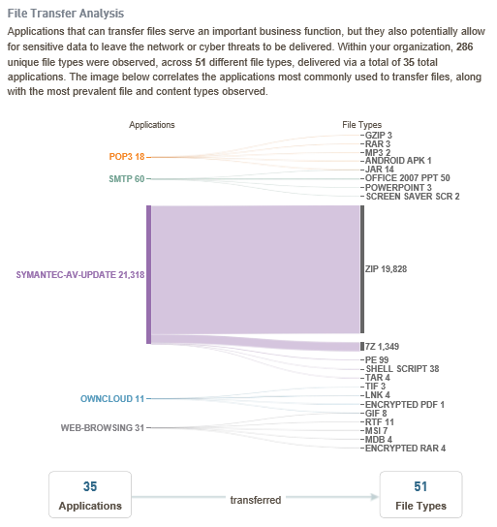
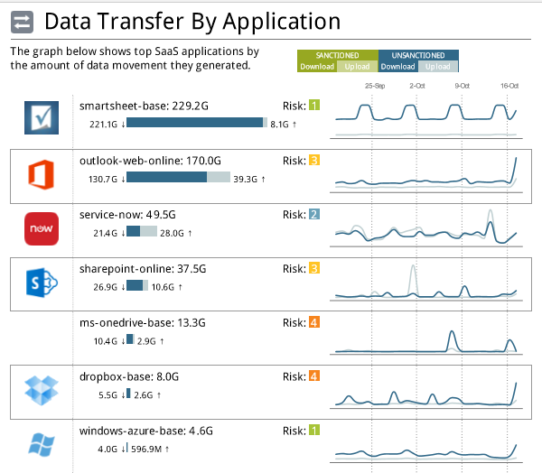
HOW AM I DOING? ARE YOU KEEPING PACE?
Relative to my industry, are my users the main source of Information Security Risk?

Slide 9
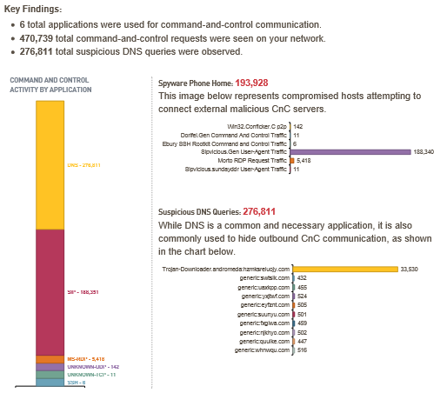
HOW AM I DOING? ARE YOU KEEPING PACE?
Am I already compromised, if so, how bad is it? What’s the frequency?
Validate this against existing URL controls and settings. Use this to help measure quality of existing tools.
Review process for closing new C&C (embedded in new Malware)
Use Behavioural Analysis to fingerprint the environment to detect insider threats.
Further questions 07588 473474

Slide 10
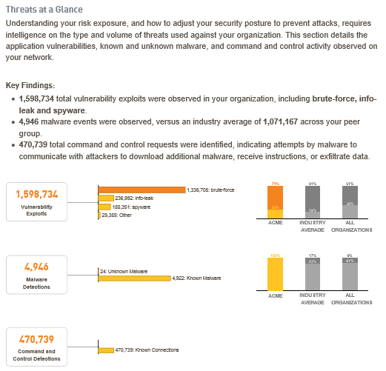
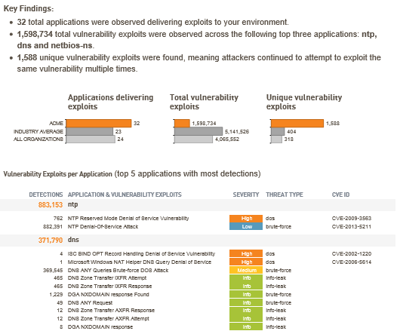
HOW AM I DOING? ARE YOU KEEPING PACE?
What am I being attacked with? How sophisticated is it? I am being attacked more than my peers?
Further questions 07588 473474

Slide 11
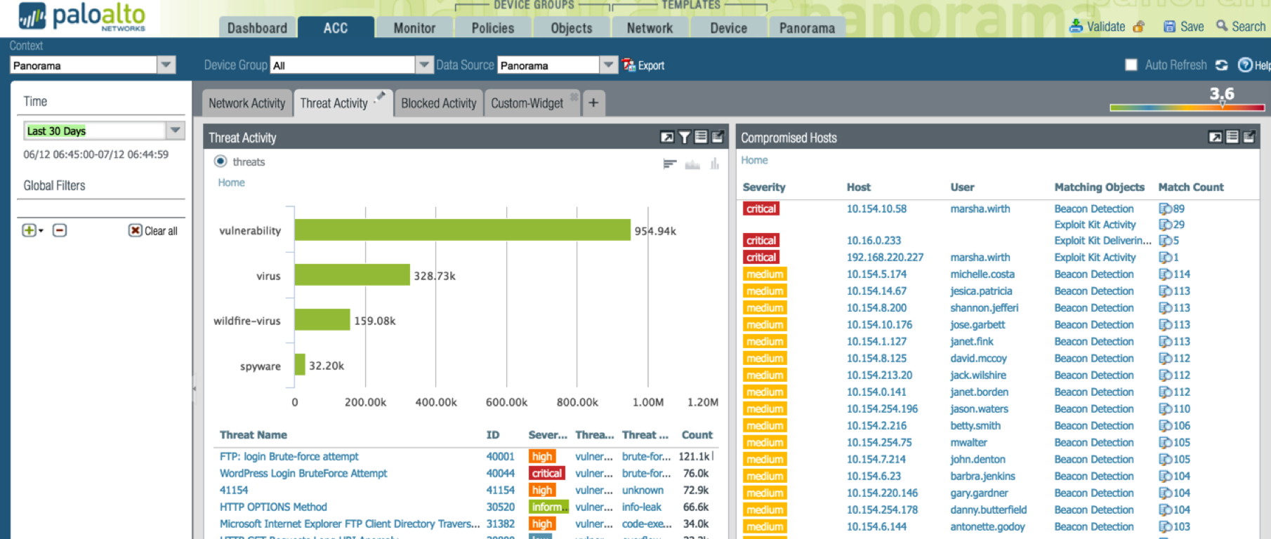
HOW AM I DOING?
Threat Name
Infected User
Type of
Compromise
No of Events
Further questions 07588 473474

Slide 12

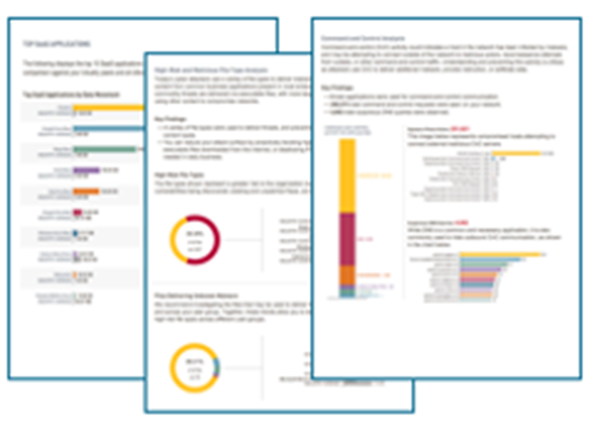
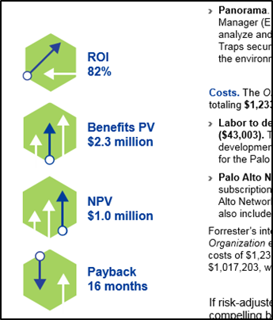

WHAT NEXT? WE JUST NEED TIME
Andrew.Belcher@cwlsystems.co.uk / 07703 221676
  Engage Palo Alto Networks (me)
Arrange Meeting / Telephone Conference
  Review the type of engagement you feel you need
    Complete Prevention Posture Assessment
    Traps Endpoint Prevention Assessment
    Security Lifecycle Review
      Per Network Segment (Internet Edge / DC)
      Per Public Cloud Environment
      Per SaaS Application
      Prices start at ZERO $ (LOAN DEVICE)
      Training Prices start at ZERO $ (Test Drive)
Further questions 07588 473474

Slide 13

Further questions 07588 473474

Slide 14
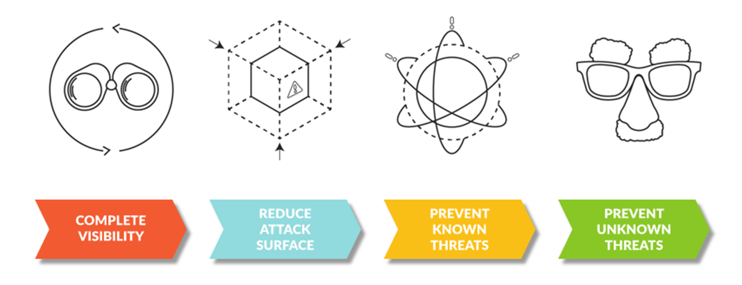
HOW AM I DOING?
Where are my weaknesses and what should I do to improve by defences? How do I measure success?
Further questions 07588 473474

Slide 15
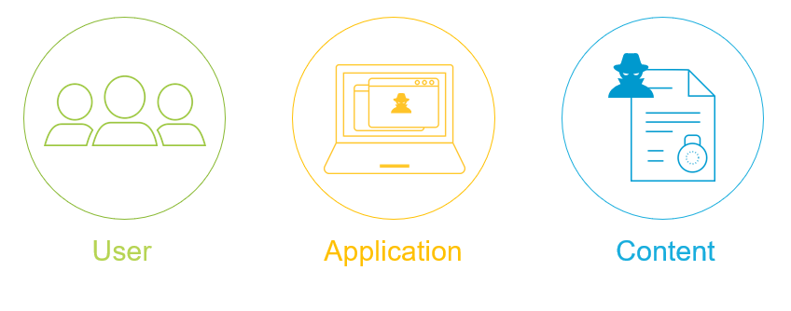
Further questions 07588 473474

Slide 16

Further questions 07588 473474

